Slide 1
Implementation of CHATBOT IN FOOD INDUSTRY
GROUP MEMBERS:-
KUNAL HADKAR (215A2132)
VARNIKA PRASAD (116A2114)
ROHIT VISHWAKARMA (116A2117)

Slide 2
FLOW OF PRESENTATION
CHATBOT IN FOOD INDUSTRY
Introduction
overview
Proposed Methodology
System Architecture
Implementation
Hardware Prototype
Advantages
Future Scope
conclusion

Slide 3
INTRODUCTION
A chatbot is basically a software that resides on a messaging platform and is developed with the purpose of having lifelike interactions with humans through text or audio.
This presentation is based on a ‘Food request accepting chatbot.’ A system at the table, with the restaurant webpage opened, serves as the communication medium.
A customer at the table can have a conversation with our bot, check the menu, etc. via the webpage and can decide and order his/her favorite dish.

Slide 4
OVERVIEW
Some programs respond intelligently like a human or similar to a human. Such a program is called as a Chatbot. Chatbots are widely popular now-a-days and catching speed as an application of computer communication. There are generally two types of chatbots- a rule-based bot which works on keywords using ‘Natural Language Processing’ or NLP, which is a subset of Artificial Intelligence or AI, and the other is a complete ‘Machine Learning and Deep Learning’ based bot. This paper addresses the design and implementation of an NLP and AI developed Chatbot system in the food industry i.e. a bot in a restaurant which will perform the complete task of taking up orders and bringing it back at your table saving up your waiting time and cutting costs required for manpower.

Slide 5
PROPOSED METHODOLOGY
The designing and development of this system can be divided into three major domains-
1. Web development.
2. Natural Language Processing based software development.
3. Hardware model using IoT.
The first domain refers to a website/webpage developed for the UI (User Interface).
The second domain refers to the actual bot program required to train the bot for appropriate responses. A python program provided with a pre-requisite restaurant dataset/database, to train the bot based on NLTK (Natural Language tool kit), is linked to the webpage using ‘Flask’ framework of python
The third domain refers to the connectivity to the ‘Hardware bot’ which works on the principles of IoT (Internet of Things).

Slide 6
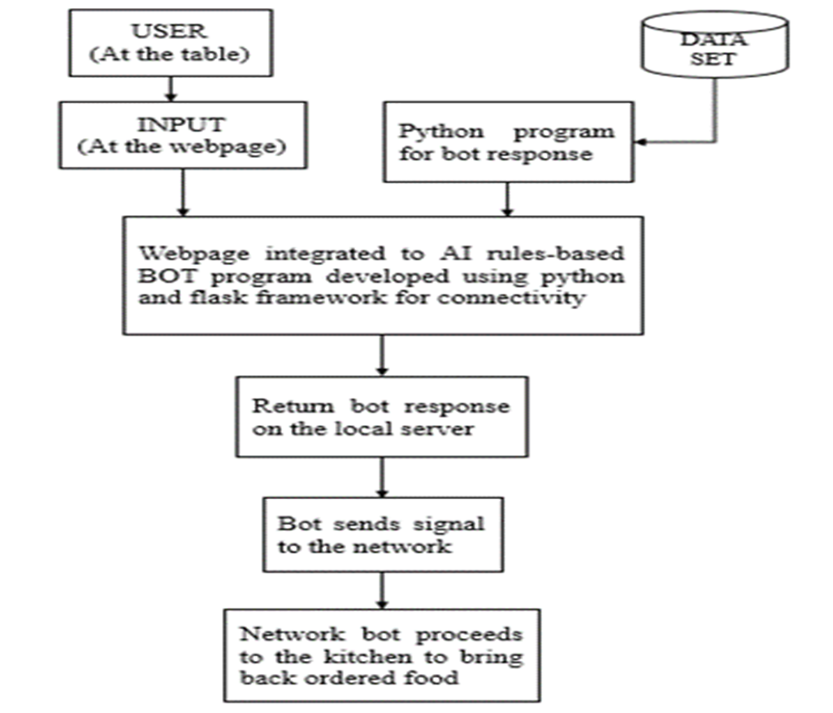
SYSTEM ARCHITECTURE

Slide 7
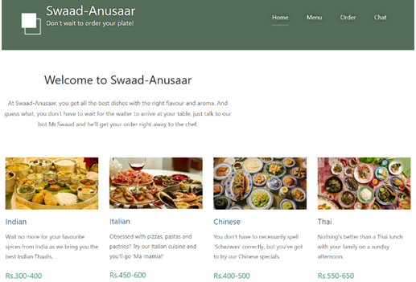
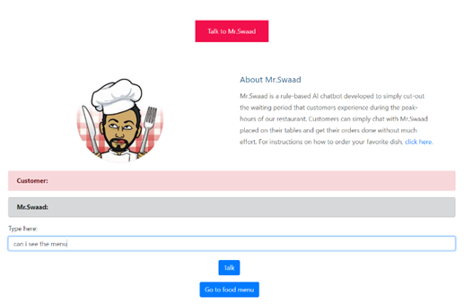
IMPLEMENTATION
Fig1:-Restaurant webpage.
Fig. 2: User input/query And Bot response

Slide 8
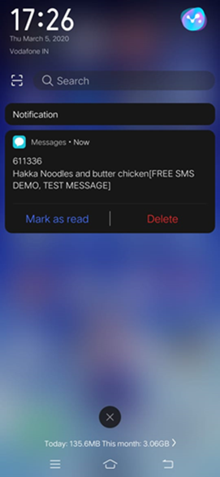
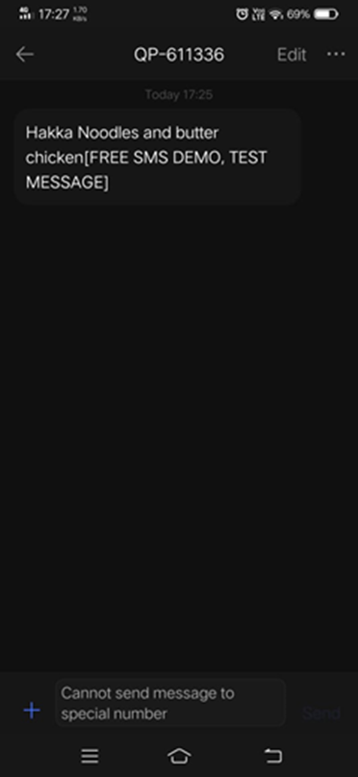
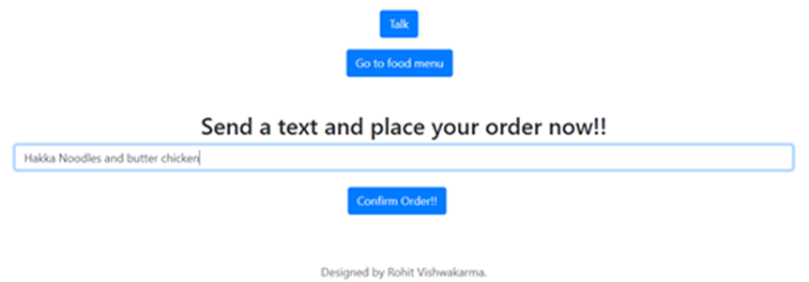
IMPLEMENTATION
Fig. 3: Confirming order.
Fig. 4: Order notification message on chef’s mobile phone.

Slide 9
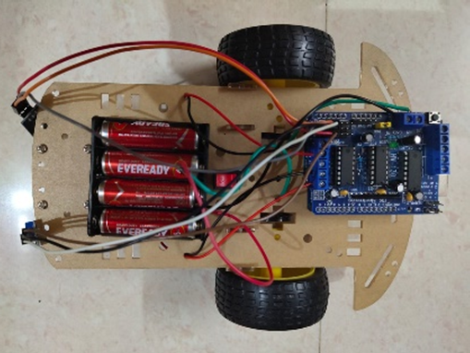
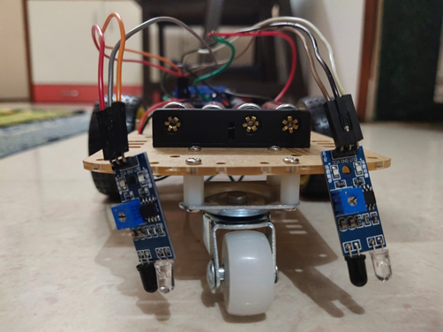
HARDWARE PROTOTYPE

Slide 10
ADVANTAGES
Customer service is Improved.
Monitoring of Customer data becomes easier and much less complicated.
Cost saving systems.
Keeping track of billing information at a push of a button.
Pre-ordering of the food is possible before reaching the Restaurant.
Feedback can be directly given to the chef or even the Manager of the Restaurant.
Multiple Admin can keep a track of the service from a remote location.

Slide 11
FUTURE SCOPE
Here we have proposed an attempt of implementation of Chatbot in restaurants and various food corners
Chatbots can effectively increase the ability of customer satisfaction and will improve sales. It is observed that the coustemer expirence gets even better when they have an virtual assistance to help them with all the help they need while ordering the food they want.
In future work we may include the functionality in such a way that the chatbots will be able to manage personalized accounts of the customers and will be able to manger their order history and will make it easier for them to keep a track of the payments made and the food ordered.

Slide 12
FUTURE SCOPE
Payments and bills will be taken care off by the chatbot itself. Since there is a Vast field of implementation of chatbots, it is hard to imagine a future without a chatbot.
As a Add-on the robot implementations of the bot can be improvised and taken to next level by making the use of Artificial intelligence.
A Feedback can be given by the customers to the robot itself.

Slide 13
CONCLUSION
In this presentation, information about the design and implementation of a chatbot in food industry has been presented. The proposed system will not only be helpful to reduce the waiting period in restaurants, but will also cut costs required for manpower for food industries and restaurant owners. With technological advent, it is also an innovative method to attract younger audience thereby increasing sales.

